Slide 1
Inventory Management System
By Ridwan Kawsar

Slide 2
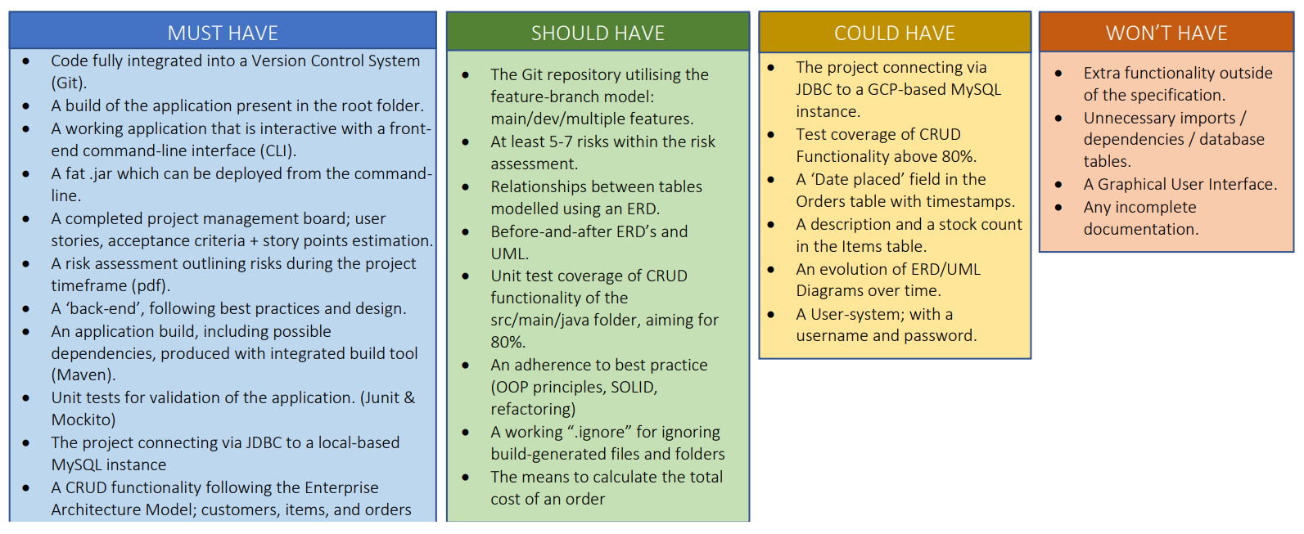
MoSCoW Prioritisation

Slide 3
Risk Assessment
Risk | Statement | Response | Objective | Likelihood | Impact | Risk Level
Data Breach | Since an IMS is being built, it is of utmost importance that data from the inventory system isn't breached. Could contain personal information such as one's names, contact numbers or even home address. | Employing data confidentiality and data integrity by limiting the amount of information stored. Using a means of encryption to hide stored data in case of a breach. Encryption has the potential to ensure data cannot be accessed. | To provide customers and clients with a sense of security and ensure that GDPR regulations are adhered to. | Low | High | Medium
Hardware Failure | Machine failure of personal equipment, i.e. PC/Laptop, could lead to a corruption of local files. Could also increase dwell time (unproductivity) if someone doesn't have access to a second machine. | Employ a plan B - either by having access to a second means of equipment or performing regular back-ups on the cloud. | Minimises the disruption that is caused by hardware failure and if regularly backed up, then it reduces the impact a corrupt file could have. It also improves data integrity; the accuracy and consistency of data stored. | Low | High | Medium
Internet Connectivity | No internet connectivity will ensure you can't access remote files or create backups on cloud hosted websites. | Having the means to a facility that offers reliable internet connection such as a café/library/academic environment could be employed to mitigate the risk. Changing Network providers or asking for a network engineer to resolve the issue. | Reduces the severity and inconvenience caused by the loss of internet connectivity. | Medium | Low | Medium
Github/Terminal | With the work constantly being pushing/pulling to and from the repo, entering wrong commands on the bash terminal may lead to the source code not being uploaded in its entirety. | Employ the Feature-Branch Model (FBM) to organise your work and only merging the branches to your development branch when you feel like you reached a milestone/checkpoint/a working completion of a feature. If the work is to be done in a secure environment then using internet hotspot from a personal mobile phone is preferred. | Keeps work organised, reduces the likelihood of working codes going missing. If it does occur, can easily be reversed by looking through commit history (git log) | High | High | High
Power cut | Power cuts can lead to a loss of data, Can come without a warning and prevent one from accessing their pc's. It's a risk out of one's control and will need to be investigated by a third party, i.e. electricians. | Mitigating this type of risk could be to save work frequently, making use of the FBM and pushing up to Git regularly. Another way could be to have external power banks and chargers to use temporarily during downtime. | Minimises the disruptions caused and since it is a risk out of our scope, having external power can reduce downtime and allow development on an object to continue. | Low | Medium | Medium
Illness | Can lead to a setback with the project, illness can vary between people to people. Response is not always the same. Can lead to a loss in development time on the IMS. | Ensuring you take the right medications prescribed and employ a healthy eating habit. Working in a clean environment and regularly cleaning hands. | Giving oneself the best possible chance of eradicating bacteria or preventing germs from being spread, or even other disease and illnesses related to food, such as food poisoning. | Low | High | Medium
Loss of Data | In the general sense, loss of data can occur from human error / accidental deletion / overwritting fully functioning codes. Data loss can also occur through third party softwares or people such as hackers. Can lead to data being comprimised and manipulated. | Making frequent implementation of version control to upload and track data so that it can be recoverable. Using cloud hosted sites to store data such as onedrive. | Ensures minimal amount of time to be consumed in the event of data being lost. | High | High | High
Software Knowledge/Ability | Writing efficient and fully functioning codes is dependent on one's ability and understanding of the programming language being used. | Asking trainer for assistance when needed, scouring the net / reading through a manual to understand what each function of the coding does. Making use of external learning sites such as Udemy, Youtube even to bridge the gap in knowledge. | To make oneself a confident developer, ensuring efficiency in one's coding. Having the mindset and ability to problem solve whether it be finding a way to make this function or resolve that error. | High | Low | High

Slide 4
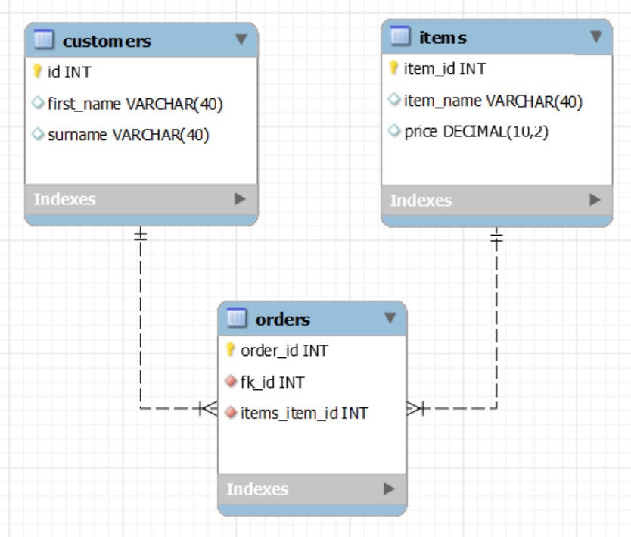
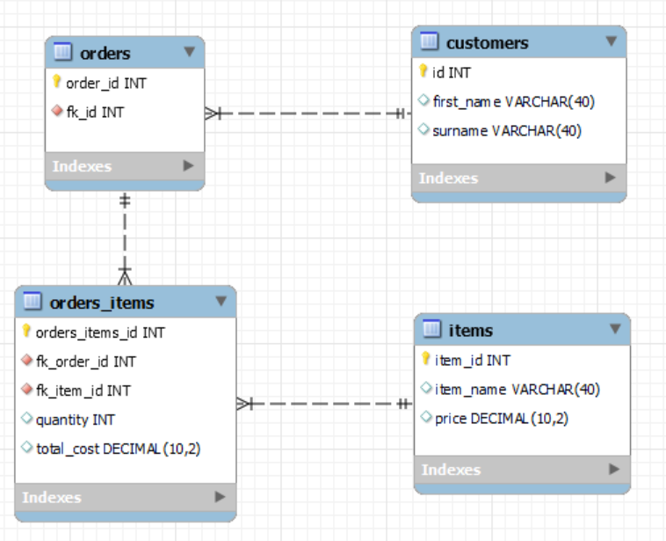
Entity Relationship Diagram (ERD) - Initial & Final

Slide 5
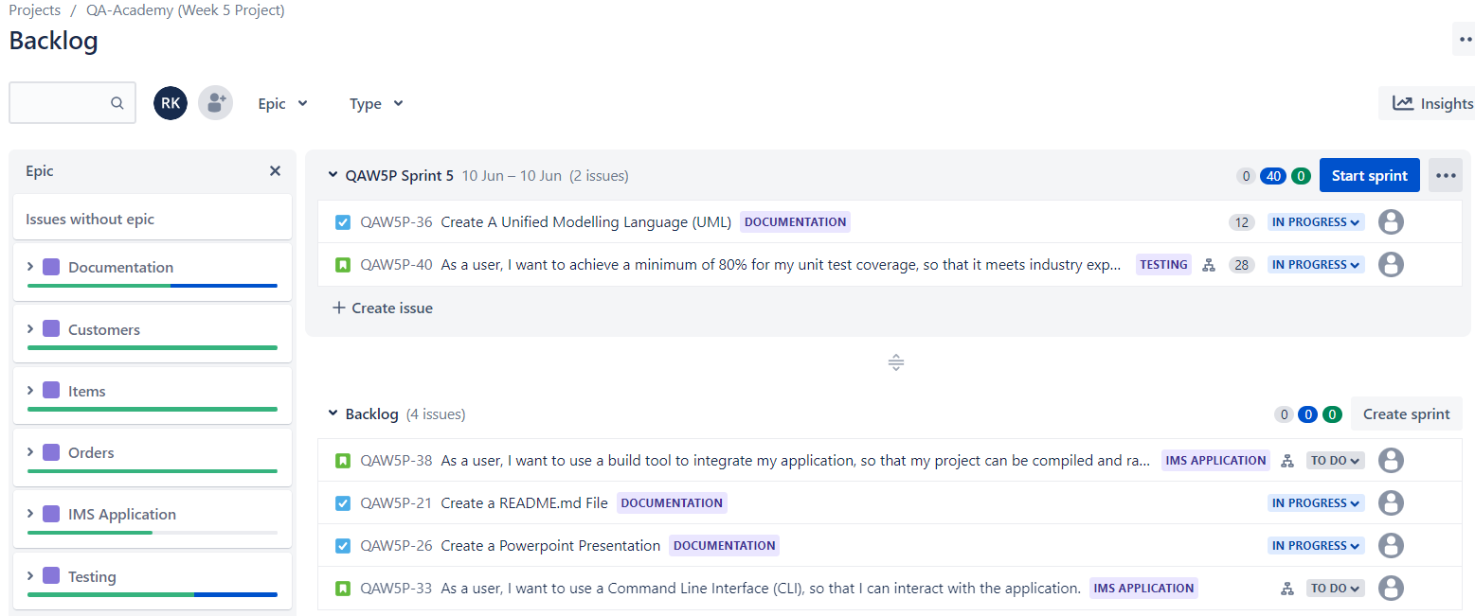
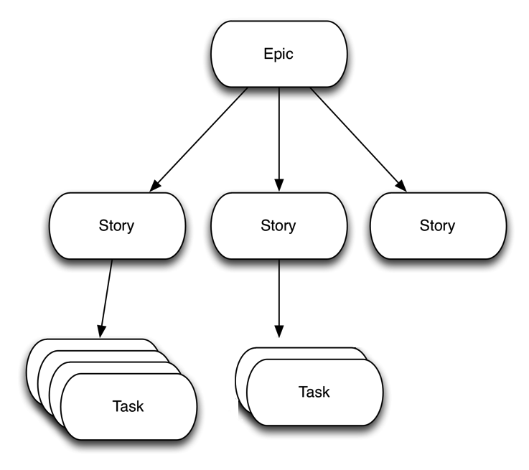
Jira Board – Epics/User Stories

Slide 6
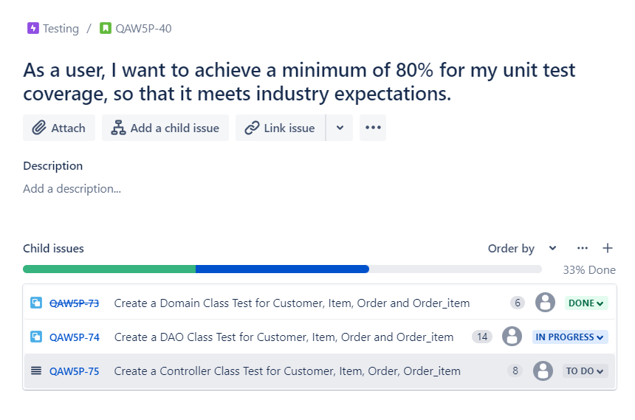
Jira Board – User Stories and Tasks

Slide 7
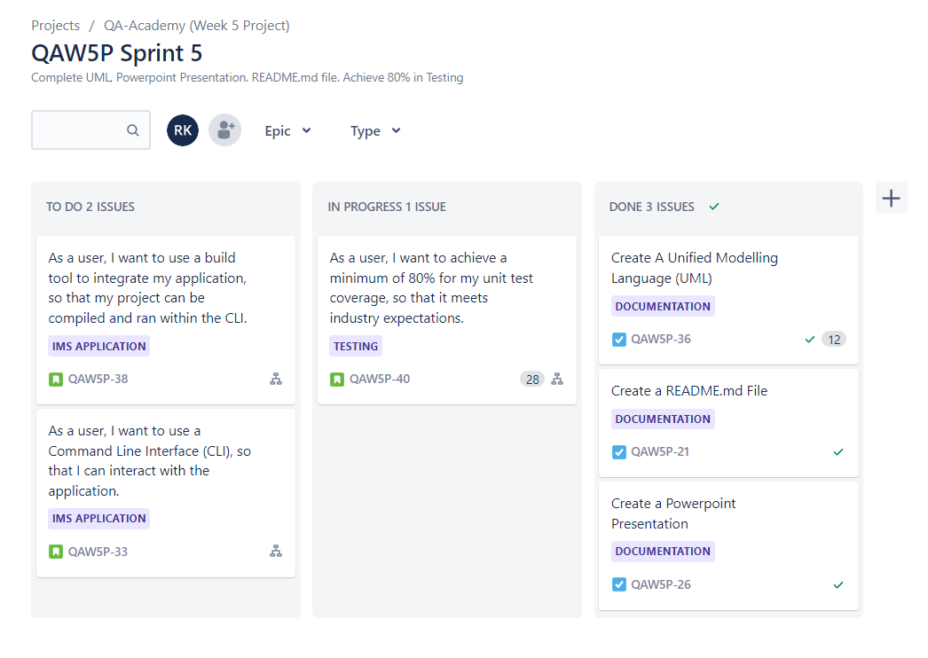
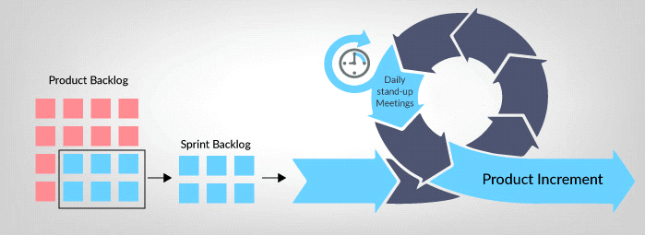
Jira Board – Sprints

Slide 8
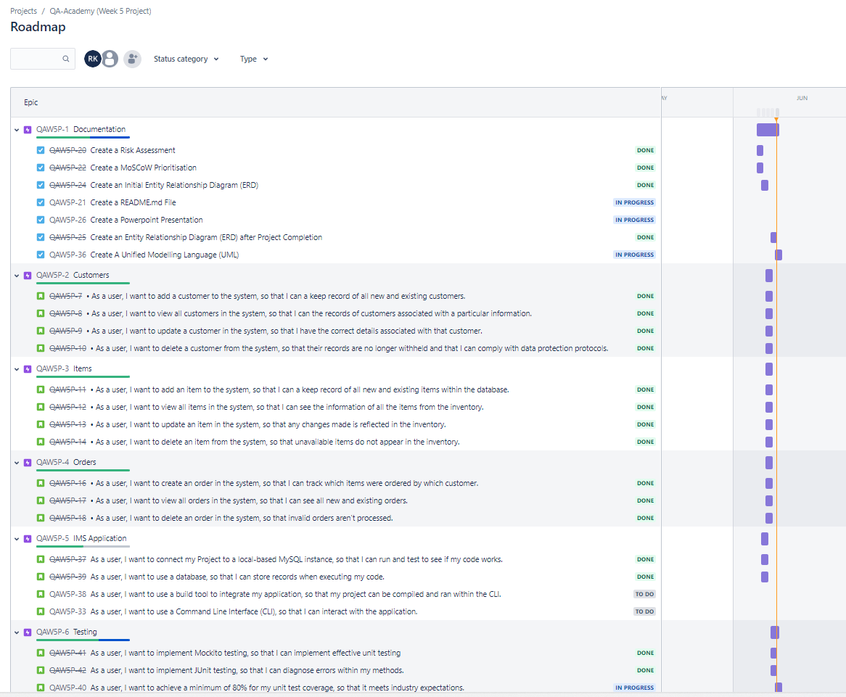
Roadmap

Slide 9
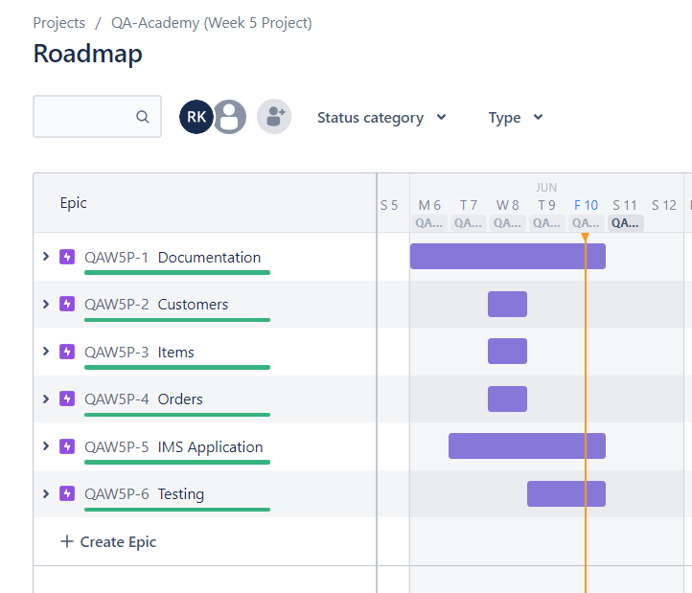
Roadmap

Slide 10
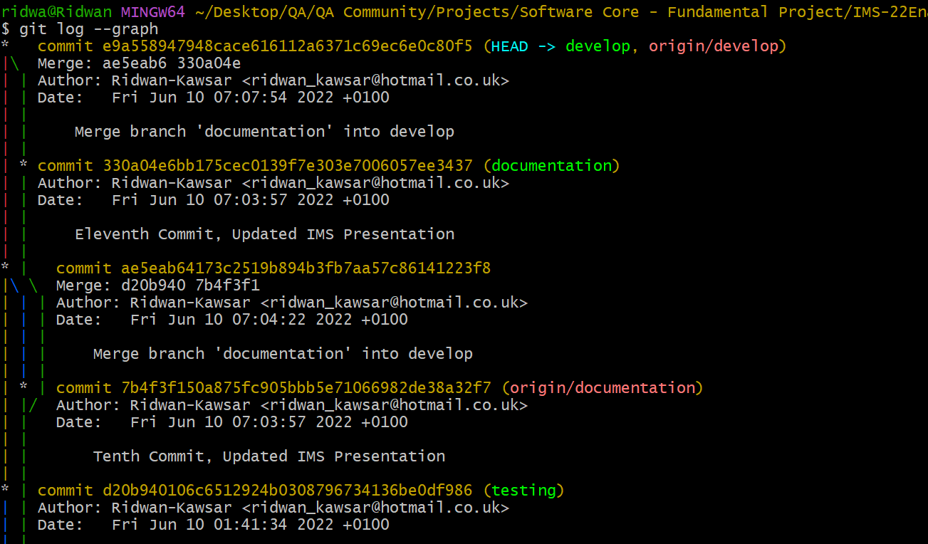
Version Control – Feature Branch Model (FBM)

Slide 11

Demo

Slide 12
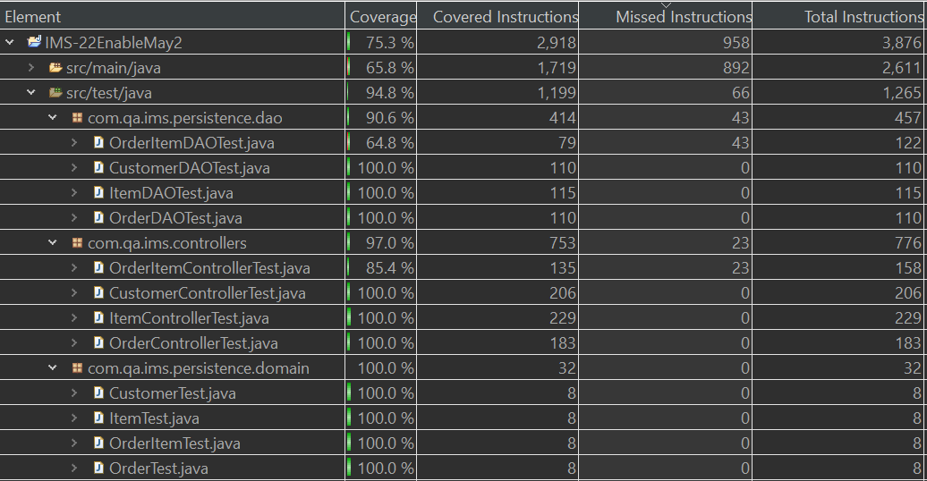
Test Coverage

Slide 13

Any Questions?

